Slide 1
REPORTLAB COMPLETE TUTORIAL
Generate Payslip From Csv Using Reportlab Python:Part 61
TOTAL TECHNOLOGY

Slide 2


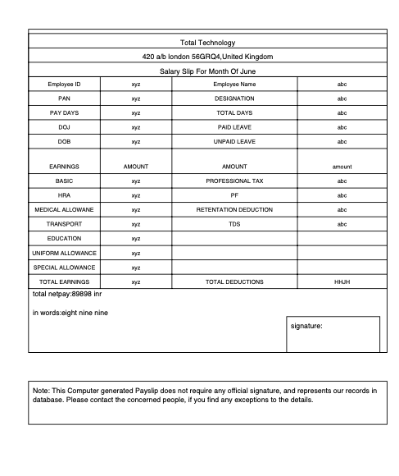

z
Payslip Template
TOTAL TECHNOLOGY

Slide 3
Code:
https://github.com/ronidas39/REPORTLAB_PYTHON/blob/master/reportlab_tutorial_61.py
TOTAL TECHNOLOGY

